Slide 1

Resisting Tag Spam by Leveraging Implicit User Behaviors
Ennan Zhai, Yale University
Zhenhua Li, Tsinghua University
Zhenyu Li, Chinese Academy of Sciences
Fan Wu, Shanghai Jiaotong University
Guihai Chen, Shanghai Jiaotong University

Slide 2





Tagging Systems
Tags are widely employed in today’s Internet services to improve the resource discovery quality in a simple, user-friendly, and easy-to-understand manner.

Slide 3
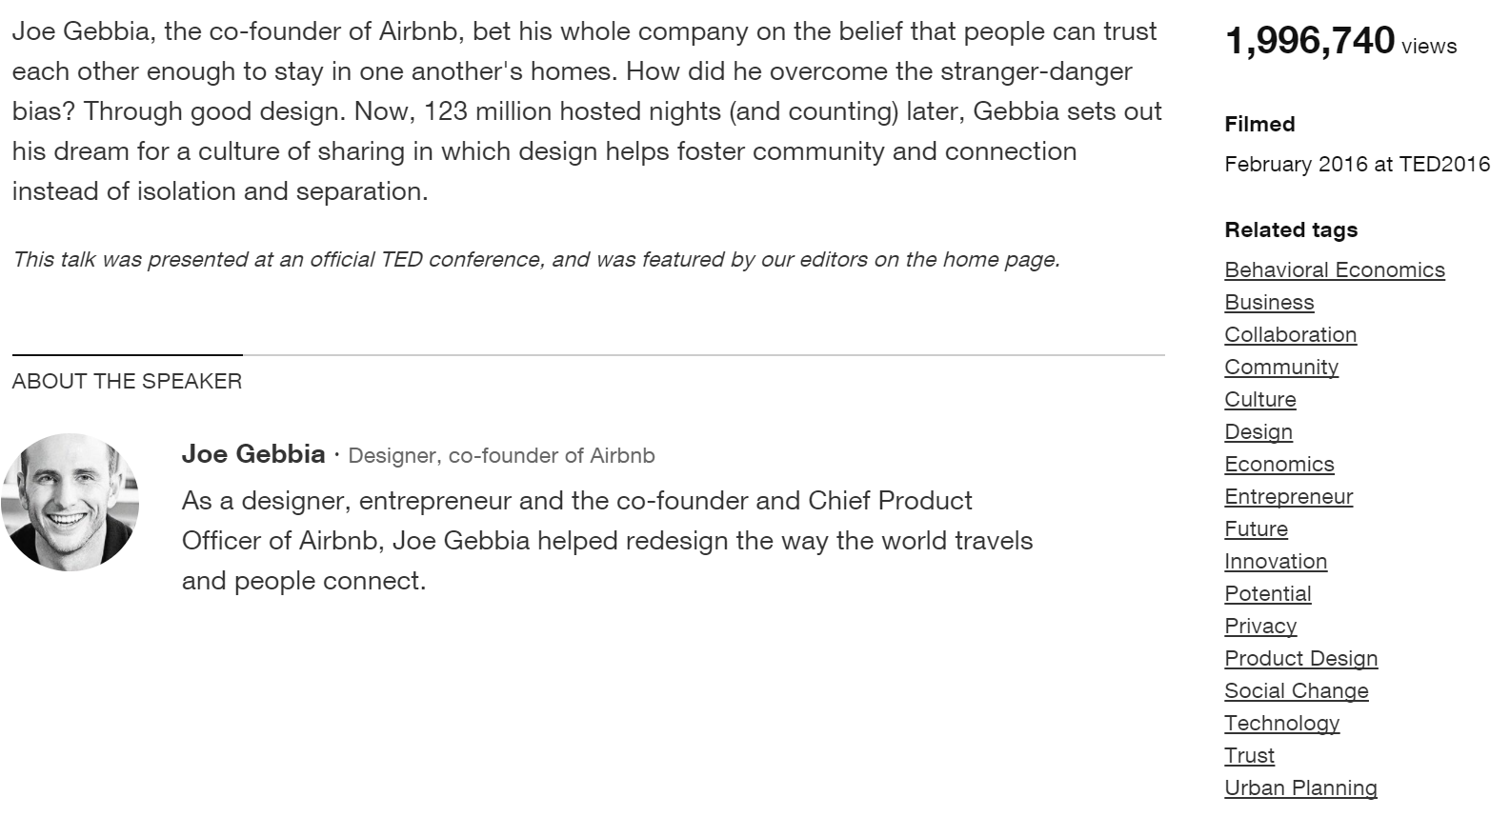
Tagging Systems
Users can find the resources of interest based on the textual tags posted by other participants
Notes:
With the help of tagging systems, …
For example, this is a TED speaker Joe Gebbia’s web page. He is the designer and co-founder of Airbnb.
In this page, he has 17 related tags characterizing his major areas and TED talk keywords.
This page has nearly 2 million views, so we believe that many viewers have benefited from these tags.

Slide 4

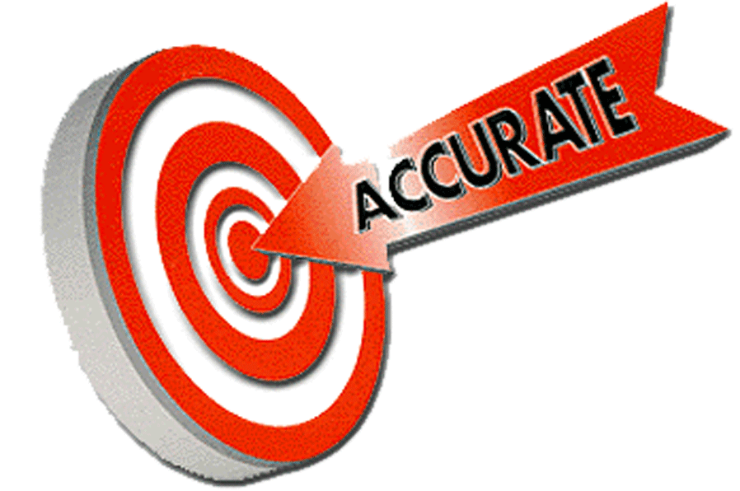
Tagging Systems
Users can search for the resources of interest using certain textual tags (i.e., a simple form of web search engine)
Notes:
TED talk tags are not only effetive but also accurate, because all of them are manually posted by either the speakers or the system administrator.

Slide 5
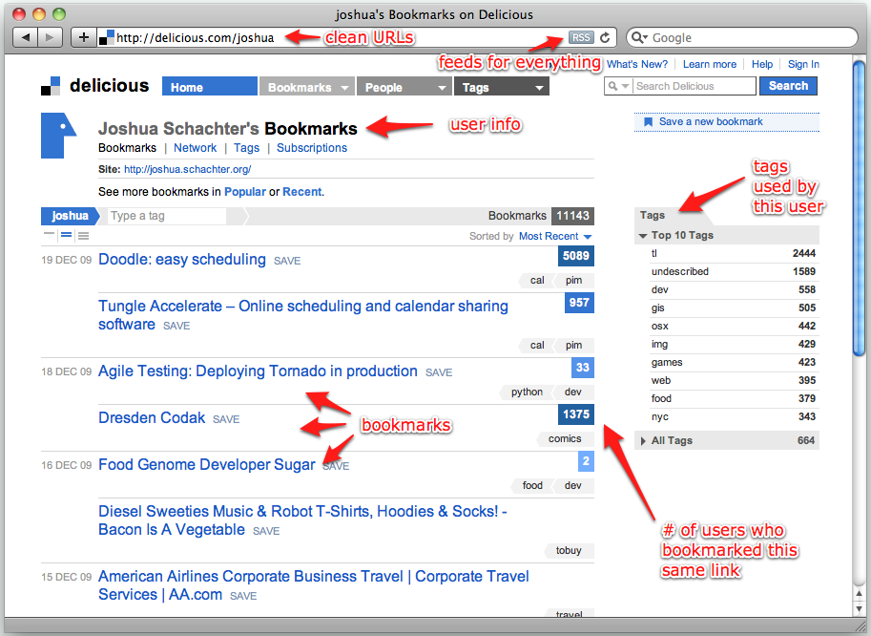
Tagging Systems
In most systems (like del.icio.us), the tags are contributed by common, uncensored users, sometimes including spam attackers
Notes:
For example in delicious, any normal user can search web pages using the tags of interest. In reality, our resource search quality significantly benefits from such a tag-based search method, which is also looked as an enhancement to conventional search engines.

Slide 6
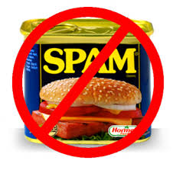
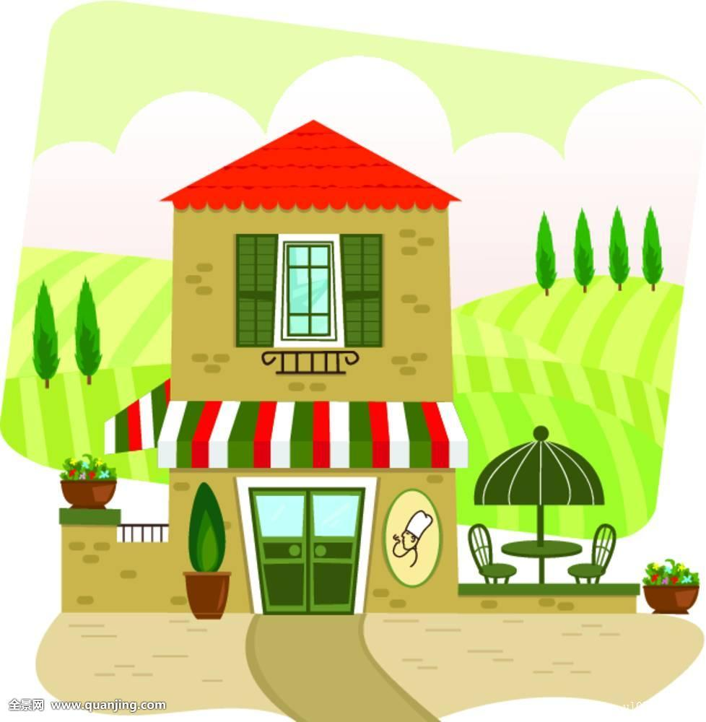
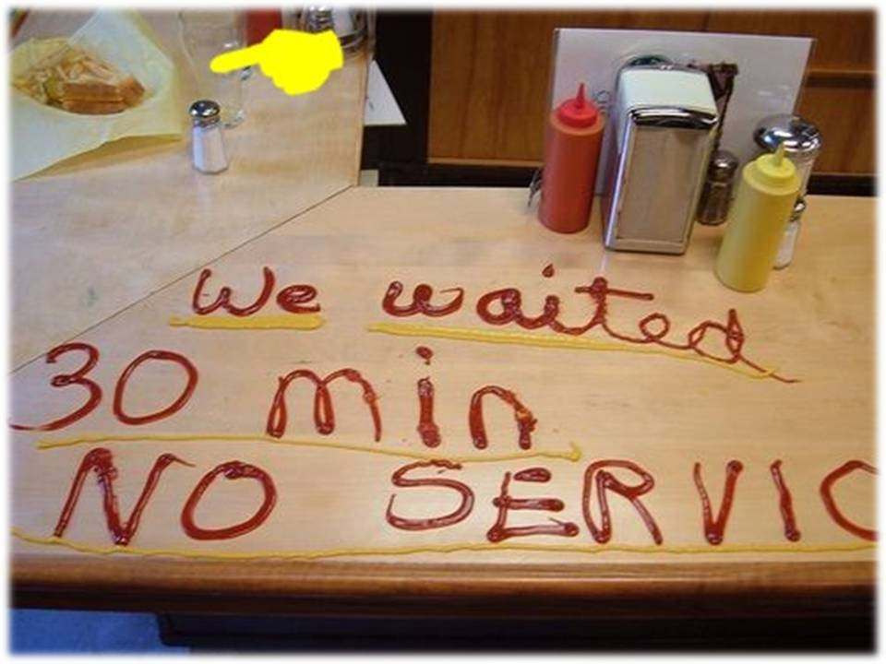
Tag Spam Problem
Ugly
Poor
Dirty
Expensive
Disgusting
Garbage
Bad
Fine
Wonderful
Delicious
Excellent service
Clean
Best startup
Bad
Hot!
Notes:
The tag spam problem is not hypothetical or trivial in today’s Internet. In practice, we often observe ridiculous situations brought by tag spam.
For example, a very decent restaurant can have a bundle of negative tags; on the contrary, an awful restaurant where you have to wait 30 minutes can have a lot of positive tags.
Obviously, attackers are exploiting tag spam to mislead normal users.
Large-scale tag spam attacks can easily bury the few correct tags, thus cheating the users even with abundant experiences.

Slide 7
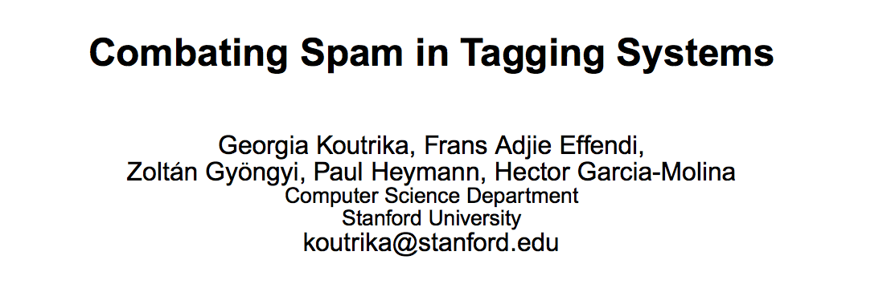
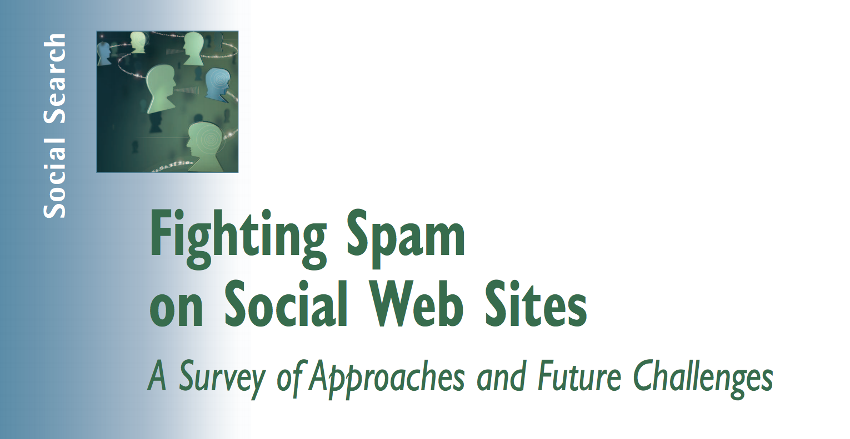
Tag Spam Problem
Notes:
Tag spam is not a novel problem. In the past a few years, many researches have been conducted to fight tag spam.

Slide 8
State-of-the-Art Efforts
Static detection: identifying spam via machine learning and data mining techniques
  Limited to specific
  spam patterns and datasets
  Introduce much computational overhead
Dynamic assessment: evaluating the quality of users’ tagging behaviors via historical activities
  Suitable to arbitrary spam patterns and datasets
  Much lower overhead
  Subject to heuristic algorithms
  No provable or quantifiable guarantees on capability
Notes:
Defending against tag spam is very important. If users frequently consume unwanted resources, the usability of tagging systems are adversely affected. Therefore, there have been many techniques proposed to address tag spam problem. We classify the state-of-the-art efforts into two groups: static detection approaches and dynamic assessment approaches.

Slide 9
State-of-the-Art Efforts
Static detection: identifying spam via machine learning and data mining techniques
  Limited to specific spam patterns and datasets
  Introduce
  much computational overhead
Dynamic assessment: evaluating the quality of users’ tagging behaviors via historical activities
  Suitable to arbitrary spam patterns and datasets
  Much lower overhead
  Subject to heuristic algorithms
  No provable or quantifiable guarantees on capability
Notes:
Static detection approaches use machine learning and data mining techniques to analyze tagging system datasets, and then detect, identify and remove tag spam matching certain target characteristics or patterns.

Slide 10
State-of-the-Art Efforts
Static detection: identifying spam via machine learning and data mining techniques
  + Quick, one-shot execution
  Limited to specific spam patterns and datasets
  Introduce much computational overhead
Dynamic assessment:
Notes:
However, existing dynamic assessment efforts are still subject to heuristic algorithms whose designs focus on addressing particular attack strategies rather than arbitrary attack models. Even worse, none of the existing dynamic assessment efforts provides provable or quantifiable guarantees. This means existing dynamic assessment approaches fail to provide theoretical proofs on “how well” these solutions are, or “why types” and “what scales” of attacks they can defend against.

Slide 11
State-of-the-Art Efforts
Static detection: identifying spam via machine learning and data mining techniques
  + Quick, one-shot execution
  Limited to specific spam patterns and datasets
  Introduce much computational overhead
Dynamic assessment: evaluating the quality of users’ tagging behaviors via historical activities
Notes:
However, existing dynamic assessment efforts are still subject to heuristic algorithms whose designs focus on addressing particular attack strategies rather than arbitrary attack models. Even worse, none of the existing dynamic assessment efforts provides provable or quantifiable guarantees. This means existing dynamic assessment approaches fail to provide theoretical proofs on “how well” these solutions are, or “why types” and “what scales” of attacks they can defend against.

Slide 12
State-of-the-Art Efforts
Static detection: identifying spam via machine learning and data mining techniques
  + Quick, one-shot execution
  Limited to specific spam patterns and datasets
  Introduce much computational overhead
Dynamic assessment: evaluating the quality of users’ tagging behaviors via historical activities
  + Suitable to arbitrary spam patterns and datasets
  + Much lower computational overhead
  Subject to the heuristic algorithms
  May need enormous time to really take effect
  No provable or quantifiable guarantees on capability
Notes:
However, existing dynamic assessment efforts are still subject to heuristic algorithms whose designs focus on addressing particular attack strategies rather than arbitrary attack models. Even worse, none of the existing dynamic assessment efforts provides provable or quantifiable guarantees. This means existing dynamic assessment approaches fail to provide theoretical proofs on “how well” these solutions are, or “why types” and “what scales” of attacks they can defend against.

Slide 13
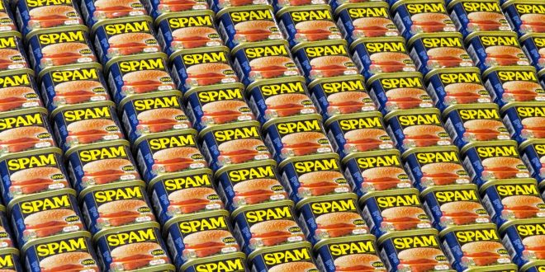

Key Problem
What if spam tags are much more than correct tags? How can we effectively find correct tags in this extreme but practical case?
Notes:
In our work, we attempt to address a key problem that has not been solved by existing researches.

Slide 14
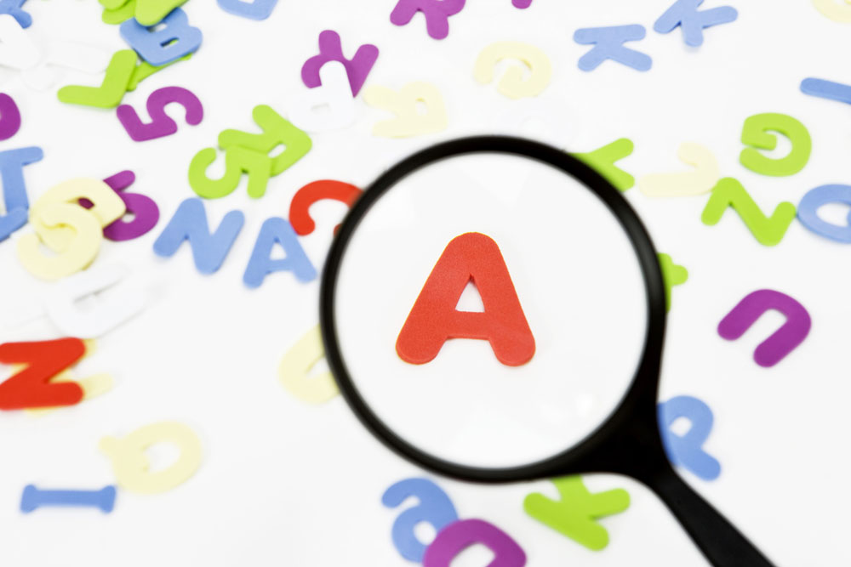
Our Goal
Is it possible to design a new dynamic assessment approach that can defend against overwhelming tag spam while holding provable guarantees?
Notes:
Driven by this problem, our goal in this paper is to answer a challenging question: …

Slide 15
Intuitive Solution
What would you do intuitively if you are the system administrator of Del.icio.us?
Ugly
Poor
Dirty
Expensive
Disgusting
Garbage
Bad
Fine
Who contributed this tag?
This should be a good guy.
Notes:
Before we introduce our specific solution, let’s first consider a simple problem: ...
You know this is a decent restaurant, but how can you distinguish the few correct tags from the numerous spam tags?
Intuitively, you will first go through a number of false tags until you find a correct tag. The you will think like, …

Slide 16
Intuitive Solution
Ugly
Poor
Dirty
Expensive
Disgusting
Garbage
Bad
Fine
What other tags are also posted by this good guy?
What about the tags posted by this good guy’s social friends?
Who else also contributed this tag or a similar tag?
Notes:
After that, you may further wonder …

Slide 17

Intuitive Solution
✔
✔
✘
✘
✘
✘
Notes:
If we can find enough good users, we can simply lift their posted tags to the top of search results.
Then those false tags are automatically filtered out or pushed back, so they can hardly deceive the users, even if their number is much larger.

Slide 18
Roadmap
I
Insights from measurement results
SRaaS algorithm design
Evaluation
II
III
7
Notes:
Now, the key point becomes: is this intuitive idea effective in the real world?

Slide 19
Measurements
To quantitatively understand users’ tagging behavior, we conducted measurements on two real-world datasets
  Del.icio.us dataset: https://goo.gl/KAvqYD
  CiteULike dataset: https://goo.gl/4kvDwm
In our measurements:
  We compute each user’s tagging similarity with other users
  We manually extract correct annotations
  We measure how many similarity cliques cover what fraction of correct annotations
Key Finding
A significant portion (e.g., C = 70%) of correct tags are contributed by a small number of (M) implicit similarity cliques. M usually lies between 10 and 50 in practice.
Notes:
To deeply understand the tagging behaviors of users, we conducted measurement experiments on two real tagging system datasets, delicious and citeulike.

Slide 20
Measurements
Two terminologies:
  Tagging similarity: the ratio of overlapping annotations between two users based on the cosine similarity.
  Implicit similarity clique: a group of users where the tagging similarities > a value between [0.5, 1], say, 0.75.
M = 3
Notes:
For example in this simple scenario, there are five implicit similarity cliques. The cliques 1, 2 and 3 together contribute 70% of correct annotations, so M is 3. Note that similarity cliques only exist at the logical level, so that no party explicitly maintains such cliques, and nobody explicitly knows which users belong to what cliques.

Slide 21
Similarity Clique Example
A real example for tagging similarity and similarity cliques:
  Extracted from Del.icio.us dataset: https://goo.gl/KAvqYD
  Red lines: users’ similarities > 0.75
  Green lines: users’ similarities <= 0.75
M = 2
Notes:
This is an example for the two terminologies. In this example, we use red lines to denote the similarity between users higher than 0.75. The green lines mean the similarity lower than 0.75. This result is extract from a real delicious dataset.

Slide 22
Roadmap
I
Insights from measurement results
SRaaS (Spam Resistance as a Service) algorithm design
Evaluation
II
III
Notes:
Let me now show you the details of SRaaS system design.

Slide 23
Spam-Resistance-as-a-Service
Alice
  Yellow boxes are operations in normal tagging systems
  Red boxes are new operations added by SRaaS
Notes:
This is the workflow of SRaaS. The yellow boxes here are operations in normal tagging systems, which include search, reply and consume. Red boxes are the operations added by SRaaS.

Slide 24
SRaaS Design
Alice
In search phase, Alice issues a tag search t to the tagging system, which is the same as in a normal tagging system.
Notes:
At the beginning, user Alice wants to have some resource, so she sends a tag query, t, to a tagging system which deploys SRaaS.

Slide 25
SRaaS Design
Alice
SRaaS finds all the resources annotated with tag t.
If there is at least one annotation whose reputation > h, SRaaS returns the corresponding resources.
Otherwise, SRaaS returns all the resources by randomly ordering them.
Notes:
SRaaS finds all the resources annotated with the query tag t in the back-end of this tagging system. Before replying the results to Alice, SRaaS runs its ranking algorithm to filter the results. In particular, if there is at least one resource whose reputation is higher than a predefined value h, SRaaS will return results only containing resources whose reputation scores higher than h.

Slide 26
SRaaS Design
Alice
SRaaS finds all the resources annotated with tag t.
If there is at least one annotation whose reputation > h, SRaaS returns the corresponding resources.
Otherwise, SRaaS returns all the resources by randomly ordering them.
The reputation of an annotation is the sum of reputation of each user who annotates this resource with t.
Notes:
The reputation of a resource is the summation of reputation score of each user who annotates this resource with the tag t.

Slide 27
SRaaS Design
Alice
SRaaS finds all the resources annotated with tag t.
If there is at least one annotation whose reputation > h, SRaaS returns the corresponding resources.
Otherwise, SRaaS returns all the resources by randomly ordering them.
h is a predefined threshold (h>=1)
Notes:
H is a predefined threshold. We typically set it as one.

Slide 28
SRaaS Design
Alice
SRaaS finds all the resources annotated with tag t.
If there is at least one annotation whose reputation > h, SRaaS returns the corresponding resources.
Otherwise, SRaaS returns all the relevant resources by randomly ordering them.
Notes:
Otherwise, if there is no resource whose reputation higher than h, SRaaS just returns all the resources in a random ordering. Later, we will talk about the intuition of this design.

Slide 29
SRaaS Design
Alice
In these phases, Alice can pick one or more resources out from the returned results and consume them.
Notes:
In the reply and consume phases, Alice just picks one or more resources out from the returned results and then consumes them. These two operations are just the same as the ones in any normal tagging system.

Slide 30
SRaaS Design
Alice
In these phases, Alice can pick one or more resources out from the returned results and consume them.
The meaning of consume is simple and general, e.g., to access the web page of a restaurant.
For simplicity, let’s use r to denote the consumed resource.
Notes:
For simplicity, we assume Alice picks out and consumes a resource r.

Slide 31
SRaaS Design
Alice
Alice annotates consumed resource r with tags: t₁, t₂, …, t_{k}
Latent feedback: whether r is correctly tagged.
If max(s(t, t₁), s(t, t₂), …, s(t, t_{k})) > 0.5, SRaaS looks Alice’s implicit feedback on r is +1; otherwise, -1.
s(.) computes tag semantic similarity via Markines tool.
Notes:
After Alice consumes the resource r, she needs to annotate r with some tags, such as t1, t2 through tk. We introduce a novel mechanism named latent feedback, which aims to inform SRaaS whether the consumed resources are correctly tagged by the query tag.

Slide 32
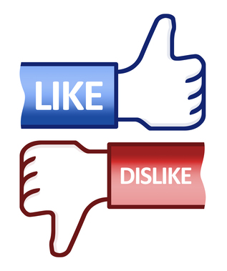
SRaaS Design
Alice
Alice annotates consumed resource r with tags: t₁, t₂, …, t_{k}
Latent feedback: whether r is correctly tagged.
If max(s(t, t₁), s(t, t₂), …, s(t, t_{k})) > 0.5, SRaaS takes Alice’s latent feedback on r as +1; otherwise, -1.
s(.) computes tag semantic similarity via Markines tool.
Note: our system also supports explicit feedback
Notes:
For example, in our case, SRaaS looks Alice’s implicit feedback on the consumed resource r by computing the tag semantic similarity between the tag she uses and the query tag t. If the tags Alice uses are very similar to her query tag t, that means this consumed resource is correctly annotated. So, SRaaS thinks Alice offers a positive feedback to the consumed resource. Otherwise, SRaaS looks the consumed resource is incorrectly tagged. Due to the latent feedback mechanism, users do not need to explicitly provide any feedback to the tagging system about whether the consumed resources are correctly tagged or not, which significantly improves the practicality and usability of SRaaS.

Slide 33
SRaaS Design
Alice
SRaaS updates annotators’ reputations based on feedback:
If feedback is +1 and r’s reputation < h, each annotator A multiplies its reputation by α; each user whose tagging similarity with A also multiplies its reputation by α.
If feedback is -1, each annotator A multiplies its reputation by β.
Notes:
After receiving the implicit feedback, SRaaS updates the annotators’ reputation scores based on Alice’s feedback.

Slide 34
SRaaS Design
Alice
SRaaS updates annotators’ reputations based on feedback:
If the feedback is +1, each annotator A multiplies its reputation by α, say 2. Additionally, we also multiply the reputations of users (by α) who are in the same similarity clique with the annotator A. (Note that a user’s reputation has an upper bound)
If the feedback is -1, each annotator A multiplies its reputation by β, say 0.2.
Notes:
If the feedback is negative one, each annotator multiples its reputation by beta. Beta should be a value lower than 1, say 0.5. Because normal users do not annotate resources with incorrect tags, such a design can effectively punish malicious users.

Slide 35
Why our design works?
Alice
Notes:
You must be wondering why our simple design works. Let me show you the intuition of our design.

Slide 36
Why our design works?
Alice
Recall our measurement results
A small number of cliques (10 - 50) covering most of correct tags (say 70%)
In our design:
+1 feedback will encounter good annotators frequently
Reputation upgrading spreads across good users, as we also increase the reputations of users with similar tagging actions.
This will always result in resources whose reputation > h
Notes:
First, recall our measurement results. We found a small number of cliques covering most of correct annotations.

Slide 37
Why our design works?
Alice
Recall our measurement results
A small number of cliques (10 - 50) covering most of correct tags (say 70%)
In our design:
+1 feedback will increase good annotators’ reputation
Reputation upgrading spreads across good users, as we also increase the reputations of users with similar tagging actions.
This will always result in resources whose reputation > h
Malicious users cannot obtain more reputations
Notes:
Once an annotation receives a positive feedback, good annotators can increase their reputations from this feedback

Slide 38
Why our design works?
Alice
Recall our measurement results
A small number of cliques (10 - 50) covering most of correct tags (say 70%)
In our design:
+1 feedback will increase good annotators’ reputation
Reputation upgrading spreads across good users, as we also increase the reputations of users within the same clique.
This will always result in resources whose reputation > h
Malicious users cannot obtain more reputations
Notes:
Furthermore, the reputation upgrading spreads across good users quickly, because we also increase the reputation scores of users who are in the same similarity clique with the annotator.

Slide 39
Why our design works?
Alice
Recall our measurement results
A small number of cliques (10 - 50) covering most of correct tags (say 70%)
In our design:
+1 feedback will increase good annotators’ reputation
Reputation upgrading spreads across good users, as we also increase the reputations of users within the same clique.
Malicious users cannot easily increase their reputations once their reputations are decreased.
Notes:
For most of malicious users, they will not have chance to increase their reputations, once their reputations are decreased. Thus, even if malicious users can gain some reputations, once they did something wrong, they will lose the reputations and would never have chance to get back. On the contrary, for normal users, because they will not do incorrect things, they can keep going very well.

Slide 40

Why our design works?
Alice
Upper Bound
Upper Bound
User’s Reputation
Clique upgrading
An effective spam tag
Number of Annotations
Number of Annotations
Notes:
For most of malicious users, they will not have chance to increase their reputations, once their reputations are decreased. Thus, even if malicious users can gain some reputations, once they did something wrong, they will lose the reputations and would never have chance to get back. On the contrary, for normal users, because they will not do incorrect things, they can keep going very well.

Slide 41
Provable Guarantees
SRaaS can bound each user’s loss within O(M) :
  User’s loss means the total number of unwanted consumed resources
  M is the number of implicit similarity cliques that publish a significant fraction of correct annotations
  M is relatively small in practice (see our measurements)
Notes:
Our simple algorithm generates provable guarantees.

Slide 42
Provable Guarantees
SRaaS can bound each user’s loss within O(M) :
  User’s loss means the total number of unwanted consumed resources
  M is the number of implicit similarity cliques that publish a significant fraction of correct annotations
  M is relatively small in practice (see our measurements)
Notes:
In general, …

Slide 43
Provable Guarantees
SRaaS can bound each user’s loss within O(M) :
  User’s loss means the total number of unwanted consumed resources
  M is the number of implicit similarity cliques that publish a significant portion of correct tags
  M is relatively small in practice (10 - 50)
Notes:
M is the number of implicit similarity cliques that publish a significant fraction of correct annotations. Given our measurement results, M is relatively small in practice.

Slide 44
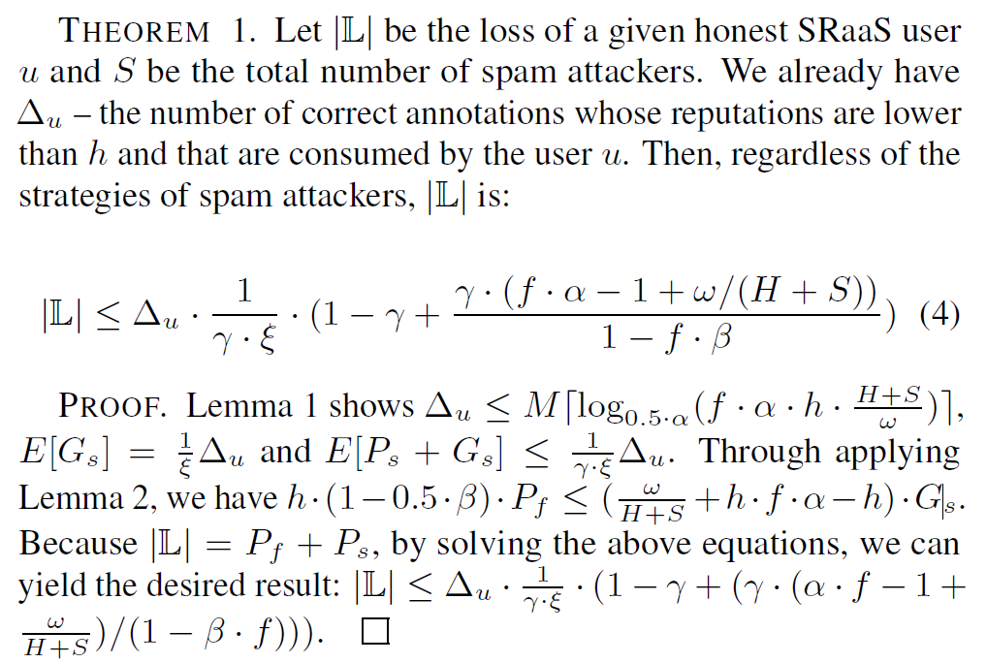
Provable Guarantees
SRaaS can bound each user’s loss within O(M) :
  User’s loss means the total number of unwanted consumed resources
  M is the number of implicit similarity cliques that publish a significant portion of correct tags
  M is relatively small in practice (10 - 50)
Please see our paper for more details …
Notes:
We provide formal proofs in our paper. Please see our paper for more details.

Slide 45
Roadmap
I
Insights from measurement results
SRaaS system design
Evaluation
II
III
Notes:
Let me now quickly show you evaluation results.

Slide 46
Evaluation Outline
Compared SRaaS with the state-of-the-art solutions
Evaluated the impact of different α and β
Measured additional overhead introduced by SRaaS
Dataset: A spam-intensive dataset
Three types of attacks
  Random spam attack
  Collusive attack
  Tricky attack
https://goo.gl/XFvTH3
Consisting of 32K users who have been manually labeled either as honest users (10K) or spam attackers (22K).
There are 2.5M resources and 14M annotations, among which there are 13M incorrect or misleading annotations.
Notes:
Due to the limited time, we just show the results of comparing SRaaS with the state-of-the-art efforts. For the rest of evaluation results, please read our paper for more details.

Slide 47
Evaluation Setup
Four counterpart solutions
  Boolean scheme (dynamic assessment)
  Occurrence scheme (dynamic assessment)
  Coincidence scheme (dynamic assessment)
  Static detection solution: SpamDetector
Three types of attacks
  Random spam attack
  Collusive attack
  Tricky attack
Tricky attackers first pretend themselves by publishing correct annotations in order to increase reputations. Then, they annotate specific victim resources with misleading tags.
Notes:
In our evaluation, we employ three types of representative tag spam attacks, random spam attack, collusive attack and tricky attack. Random attack just randomly selects incorrect tags to annotate resources with these randomly chosen tags. For collusive attack, malicious users annotate many same resources with the number of the same misleading and popular tags to make these resources easy to be searched. Tricky attackers first pretend themselves by publishing correct annotations to gain the credits, and then annotate specific victim resources with misleading tags.

Slide 48
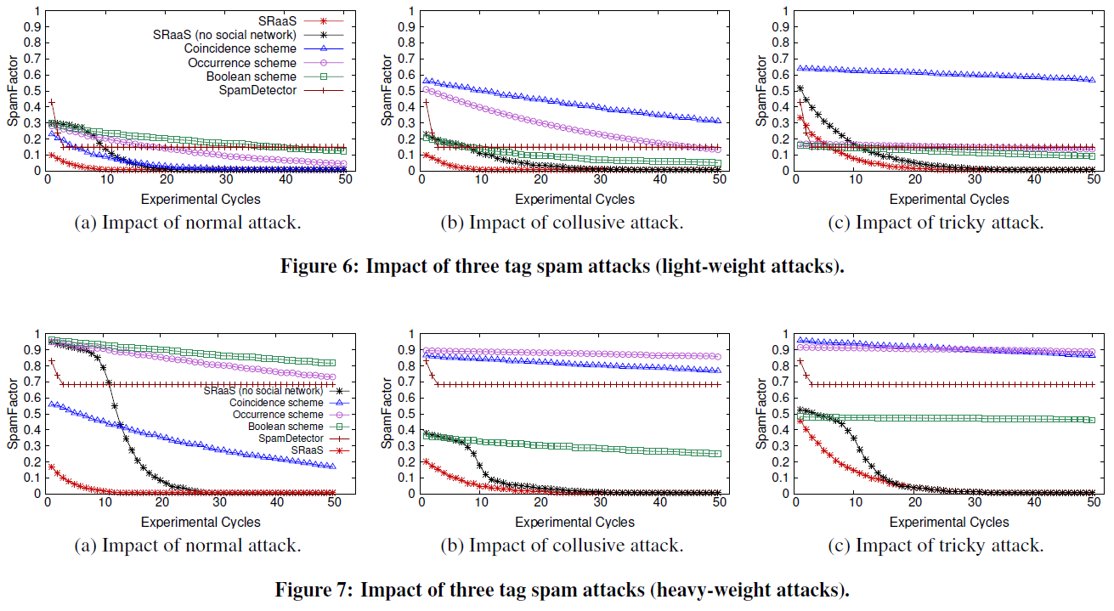
Light-weight and Heavy-weight Attack
Even under heavy-weight attacks, a given SRaaS user can always obtain spam-free search results after about 15 tag queries. In comparison, the search results of the other four solutions are still occupied by tag spam even after 50 queries.
Notes:
This is the result of launching lightweight random attack to all the tag search models. Lightweight means in each experimental cycle, 10-50 misleading tags are generated. As shown in this result, Boolean scheme and static scheme are affected badly, and other schemes behave quite well.

Slide 49
Conclusion
Key Finding from Real-world Measurements
A significant portion of correct tags are contributed by a small number of (M) implicit similarity cliques.
SRaaS is a novel tag spam-resistant algorithm
  It targets large-scale spam attack models and scenarios
  Simple design with not simple, provable guarantees on the defense capability
  Effectiveness and efficiency evaluated on a real dataset
Comments? Questions? ☺
Notes:
In conclusion, SRaaS is a novel tag spam resistant service. It targets heterogeneous attack models and arbitrary tagging service scenarios. In addition, SRaaS provides provable guarantees on its defense capability. Our experiment results based on real-world and spam-intensive dataset have demonstrated that SRaaS is effective to tag spam and the system is efficient.

Slide 50
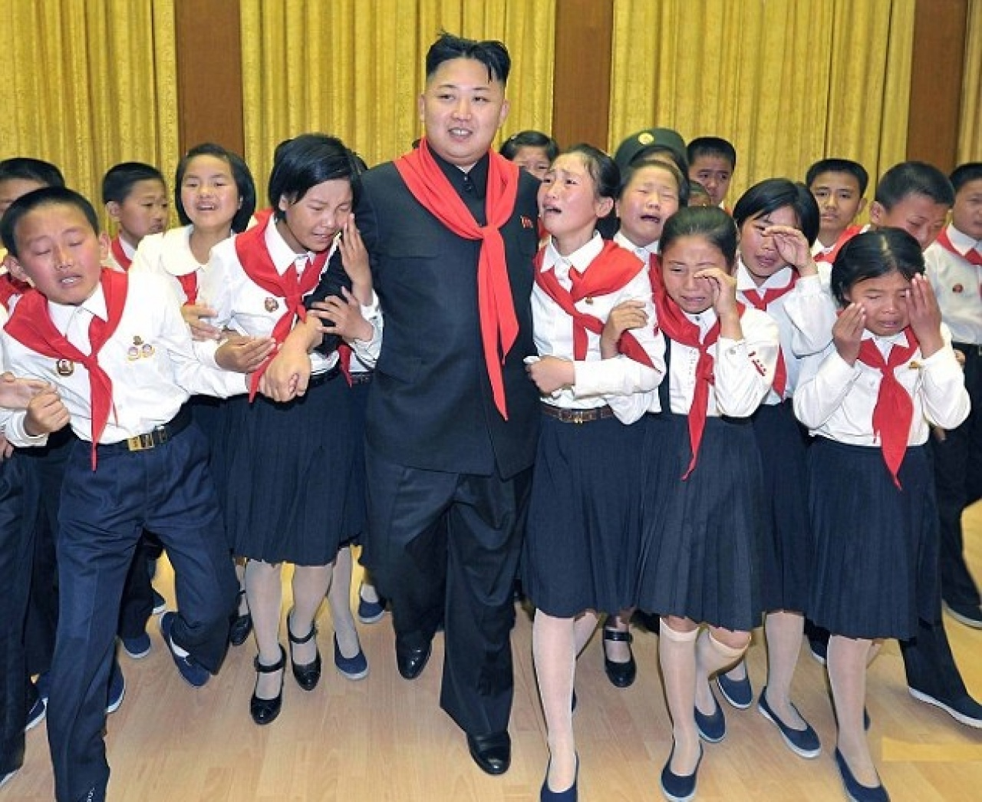
Sybil Attack
Sybil attack is the most expensive and effective
  In general, it will increase the value of M, so each user’s loss is expected to be increased
  In the extreme case, it will disable our key finding and thus make our SRaaS algorithm ineffective
Notes:
In conclusion, SRaaS is a novel tag spam resistant service. It targets heterogeneous attack models and arbitrary tagging service scenarios. In addition, SRaaS provides provable guarantees on its defense capability. Our experiment results based on real-world and spam-intensive dataset have demonstrated that SRaaS is effective to tag spam and the system is efficient.

Slide 51

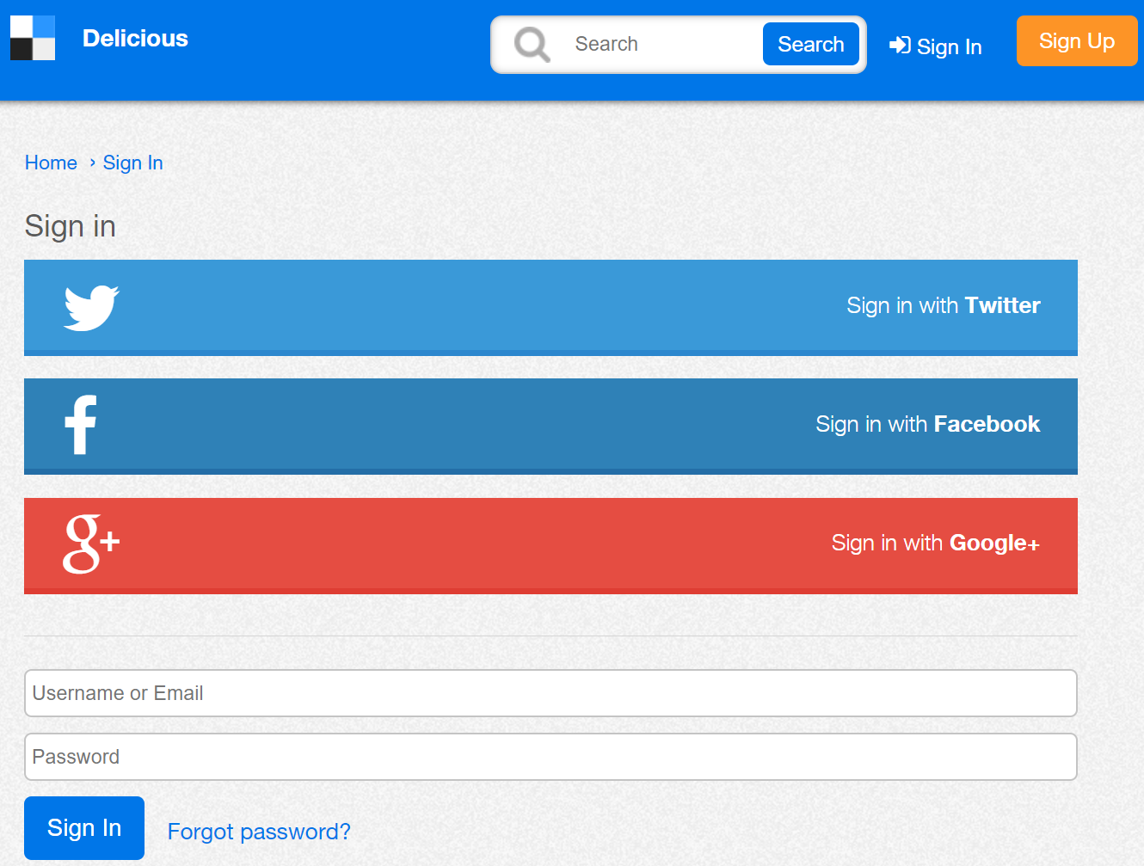
Cold Start Problem
The dynamic assessment approach
  + Suitable to arbitrary spam patterns and datasets
  + Much lower computation overhead
  May need enormous time to really take effect, especially for a new comer who has very little reputation
Quick start by importing her social-network friends’ reputations
Notes:
In conclusion, SRaaS is a novel tag spam resistant service. It targets heterogeneous attack models and arbitrary tagging service scenarios. In addition, SRaaS provides provable guarantees on its defense capability. Our experiment results based on real-world and spam-intensive dataset have demonstrated that SRaaS is effective to tag spam and the system is efficient.

